Slide 1
Group 7 -
Wendy Ralston, Moksha Shah, Darshi Shah
Antiques by Anna Analysis

Slide 2

Analyzing the Digital Journey of
Antiques by Anna
Our project analyzes website performance, engagement patterns, and customer behavior using data from Google Analytics.
With a focus on customer experience, we evaluated what’s working — and what’s not — across the site, especially from the lens of our customer persona: Sasha, a high-end, style-savvy vintage collector.
This analysis aims to uncover actionable solutions to improve conversion, retention, and community engagement for the brand.
Introduction
What does Sasha experience when she visits Anna’s site — and why doesn’t she stay?
Notes:
Hi everyone, my name is Moksha, and i’m here with Wendy and Darshi. We will be walking you through our digital analysis of Antiques by Anna.
Our project focuses on evaluating the brand’s online performance using data from Google Analytics, while also exploring how the overall customer experience aligns with business goals.
We didn’t just look at numbers — we looked at behavior. We wanted to understand not only how users interact with the website, but why they behave that way.
To ground our analysis, we developed a customer persona named Sasha — she’s a high-end, style-conscious vintage collector who shops with intention and emotion. Everything we explored in this project was viewed through Sasha’s eyes— what excites her, what turns her away, and what keeps her coming back.
Ultimately, our goal was to uncover specific, actionable insights that can help Anna improve engagement, increase conversions, and build a stronger sense of community around her brand.
So the real question guiding this project is: why users like Sasha aren’t staying — and what Anna can do to turn first-time browsers into lifelong collectors.

Slide 3
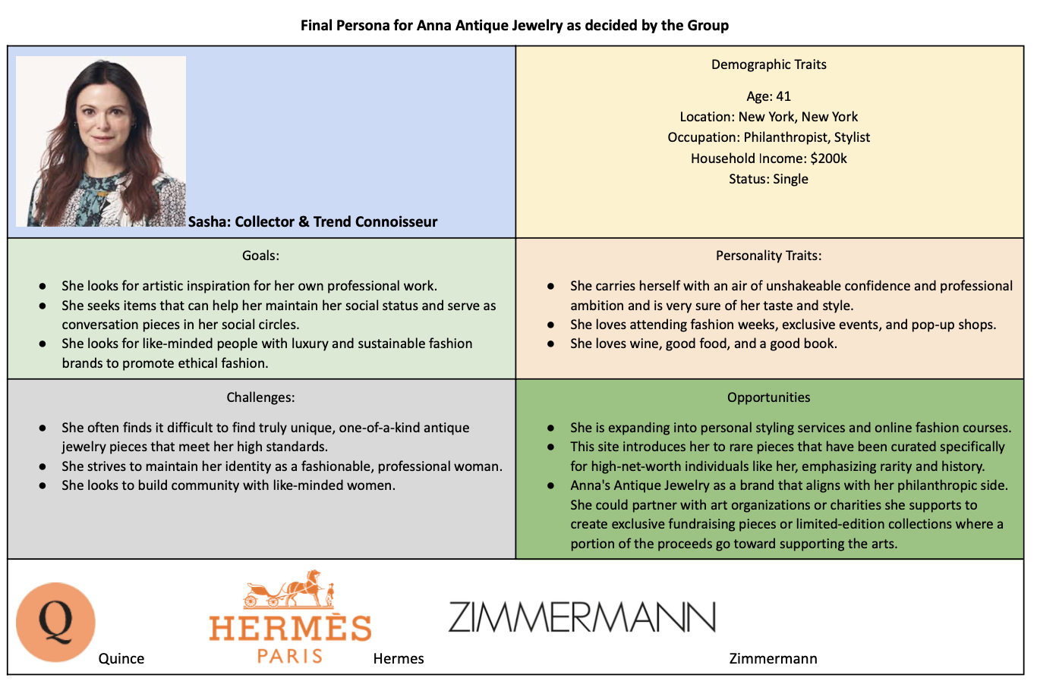
Persona Creation
Every insight in our project is filtered through one key question: Would Sasha stay? Or bounce?
Antiques by Anna has the pieces — now it needs to deliver the experience to keep Sasha.
Notes:
Let me introduce you to Sasha, the persona we created to guide our analysis.
Sasha is a 41-year-old stylist and philanthropist based in New York City, with a household income of around $200K. She’s elegant, confident, and deeply invested in both personal style and meaningful consumption. She’s not just a shopper — she’s a collector.
Sasha looks for rare, one-of-a-kind vintage pieces that inspire her professionally and serve as conversation starters in her social circles. She gravitates toward brands that are not only luxurious, but also align with her values — especially around sustainability and ethical fashion.
However, Sasha often feels disappointed by online stores that don’t meet her standards — either visually, emotionally, or in the shopping experience itself. She wants styling inspiration, story-driven curation, and a feeling of connection with the brand.
She’s also someone who values community and culture. She supports the arts, attends fashion weeks, and enjoys exclusive events. So when a brand like Antiques by Anna fails to deliver that sense of exclusivity or narrative, she’s unlikely to return.
Throughout this project, we consistently asked: Would this resonate with someone like Sasha? If not, we treated it as a gap worth addressing.

Slide 4
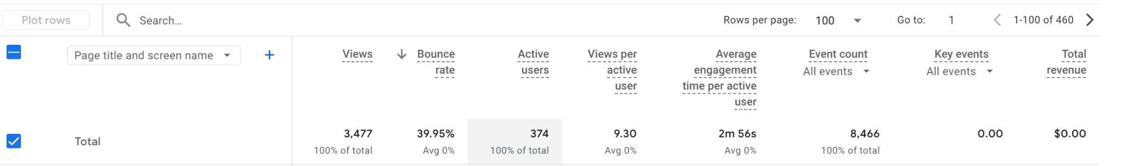
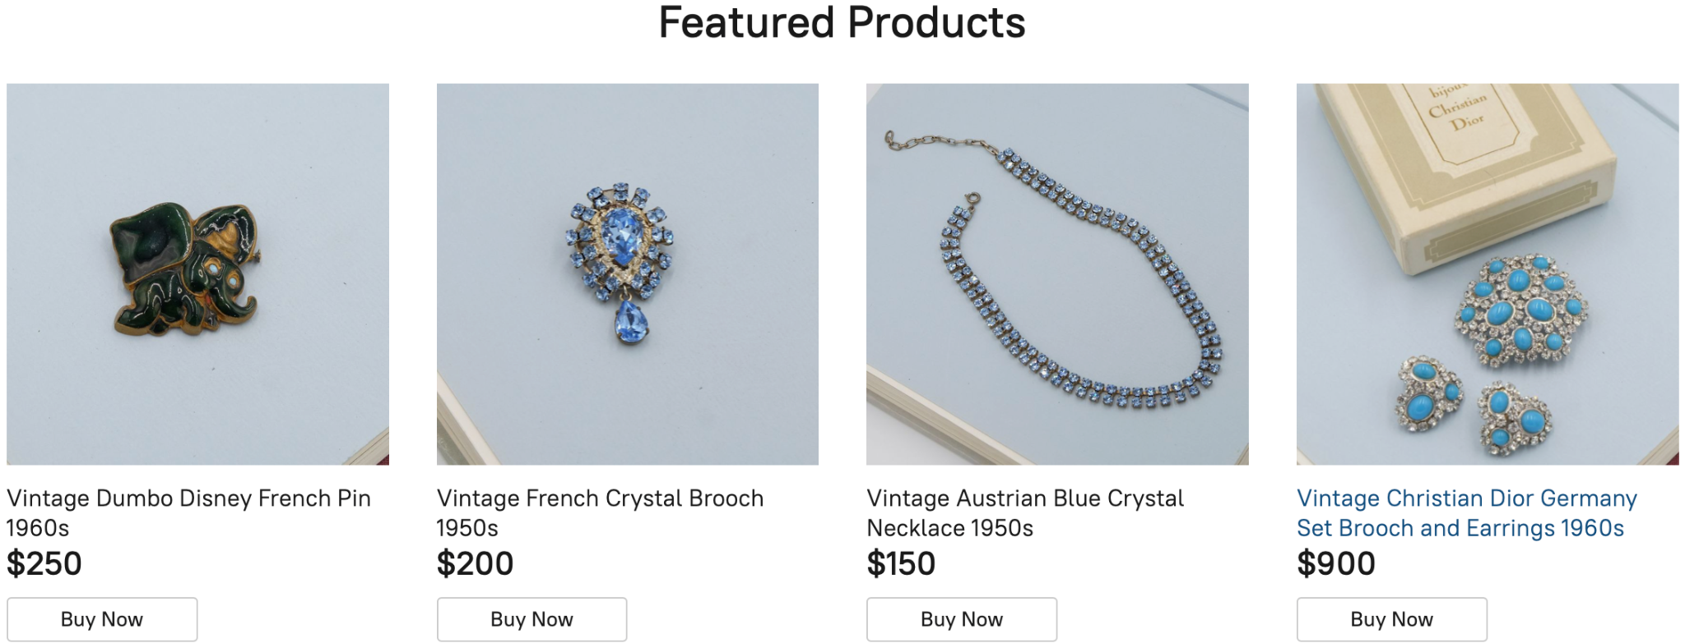
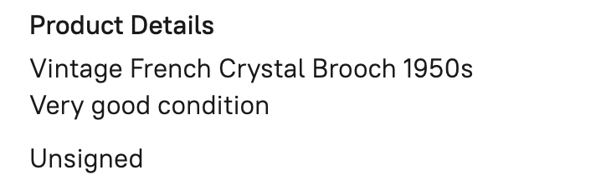
Poor Landing Page Engagement (High Bounce Rate)
Why Visitors Land… and Leave
Google Analytics shows high bounce rate, especially from Instagram traffic
Users land on generic product grids — no hook, no story, no CTA
No strong welcome message, curated themes, or emotional hook
Featured products exist, but they don’t tell a story or guide the experience
Feels like a catalog, not a curated vintage experience
Web Analytics Results
Notes:
Let’s start with one of the biggest issues we uncovered — landing page engagement.
The Google Analytics data shows a bounce rate of nearly 40%, which is especially high. These are people who are already intrigued by the brand — but something’s going wrong when they land.
Most visitors are dropped straight onto a generic product grid, with no welcome, no messaging, and no sense of direction.
Sure, there are featured items, but they lack context or storytelling. It’s just a plain product image, a price tag, and a lifeless line like ‘Very good condition.’There’s nothing personal, no spark of curiosity, and nothing visually inspiring.
To someone like Sasha, who shops based on emotion, heritage, and styling — this feels flat. It’s not that the pieces aren’t beautiful — it’s that they’re not being introduced beautifully.
Anna’s site has the jewelry. What it’s missing is the mood, the story, and the vibe to keep Sasha — or anyone — from bouncing.

Slide 5
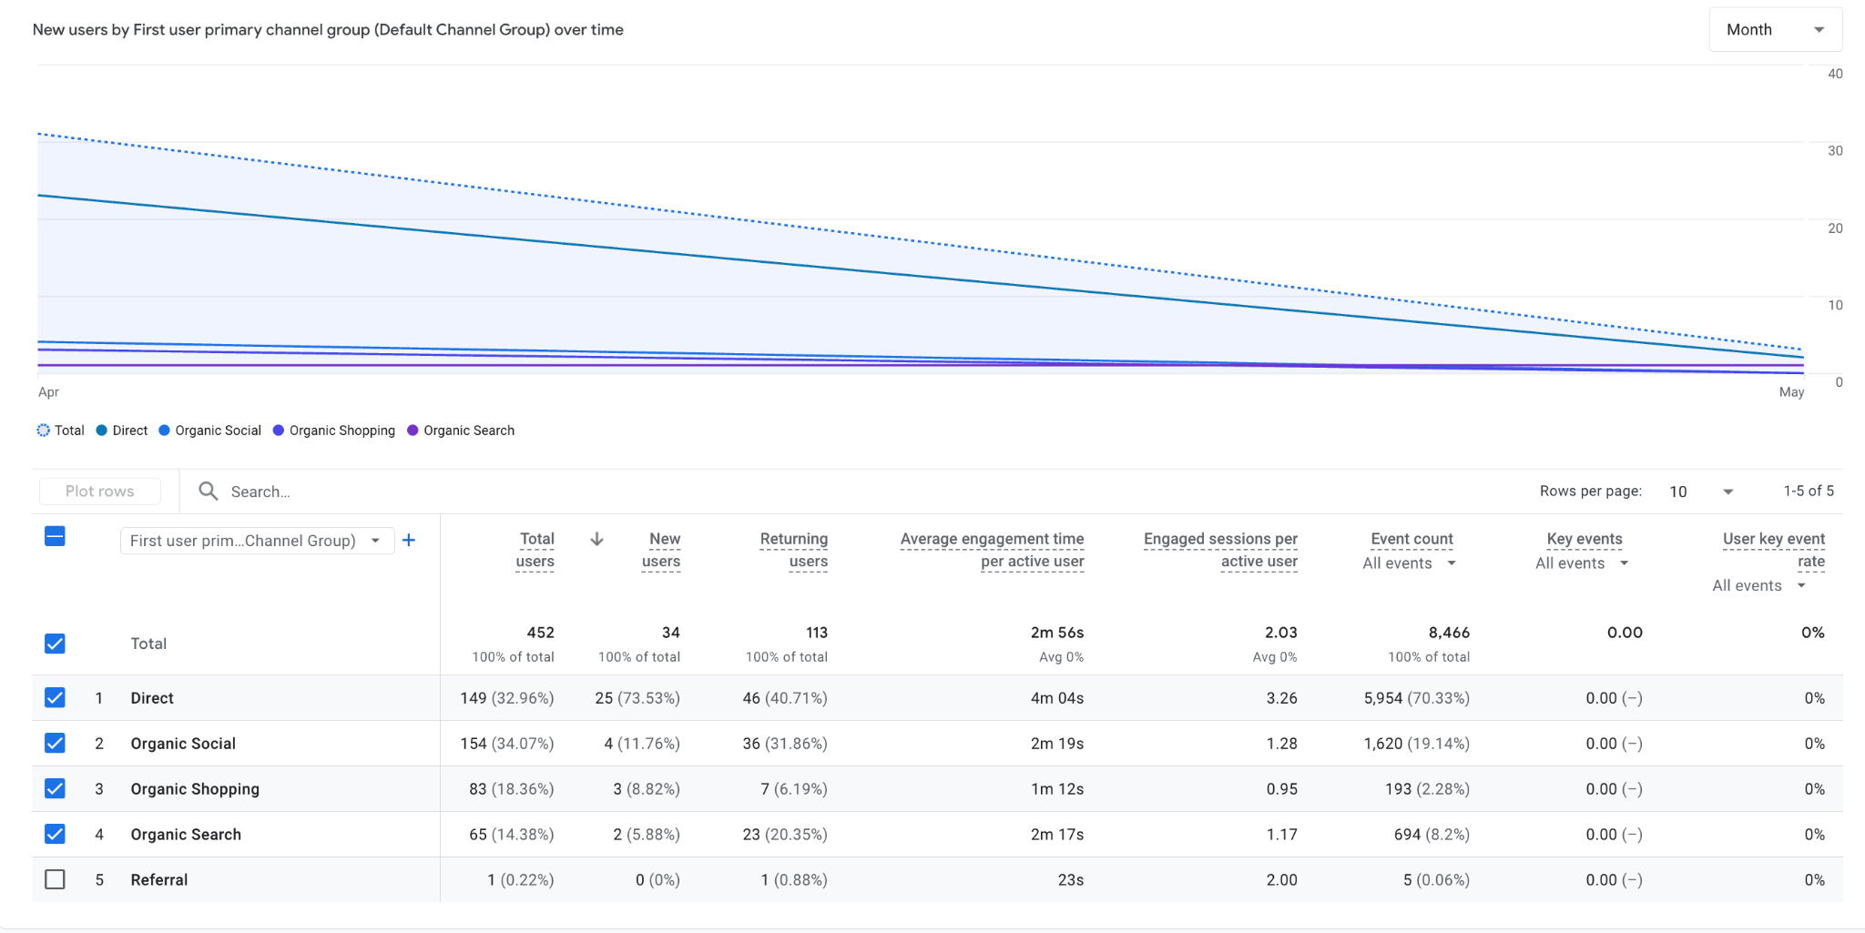
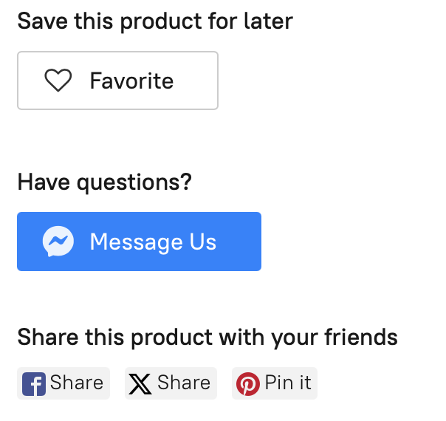
Weak User Retention & Limited of Follow-Up
Why Visitors Don’t Come Back
Google Analytics shows a low percentage of returning users
No clear email signup prompt or “Join the Collector’s Circle” incentive
“Favorite” feature exists, but is buried and not tied to an account or email
Cart abandonment email exists, but it's delayed and only triggers in limited cases
Sharing options (Facebook, X, Pinterest) are present but not emphasized or integrated into a broader engagement strategy
The 15% off promo is automatic — it’s not leveraged for building a long-term connection
No personalized messaging, loyalty program, or lifestyle content to keep Sasha engaged - Once Sasha leaves, there’s barely a whisper to bring her back.
Web Analytics Results
Notes:
When we looked at the Google Analytics data, one thing was clear: Sasha doesn’t come back. The percentage of returning users is very low, which suggests that the brand isn’t doing enough to build long-term engagement or loyalty.
There’s no clear email sign-up prompt — no “Join the Collector’s Circle” or even a lifestyle newsletter to keep her connected.
And while the site does let you "Favorite" a product, that feature is buried in the product page and doesn’t connect to an account, email, or app notification. So it becomes a one-time action — not a loop back in.
There is a cart abandonment email, but it’s delayed, inconsistent, and limited to users who add an item to the cart — not those who favorited something or browsed deeply.
And though social share buttons like Facebook, X, and Pinterest exist — they’re not emphasized or tied into a broader content or community strategy.
Another issue? The 15% off discount is automatic. It’s not used as a strategic conversion tool — no exclusivity, no countdown, and no email required. So you get the perk, but not the relationship.
Overall, once Sasha leaves — there’s no re-engagement touchpoint. No loyalty program, no storytelling, no follow-up.
Now Wendy will take you through some actionable fixes.

Slide 6
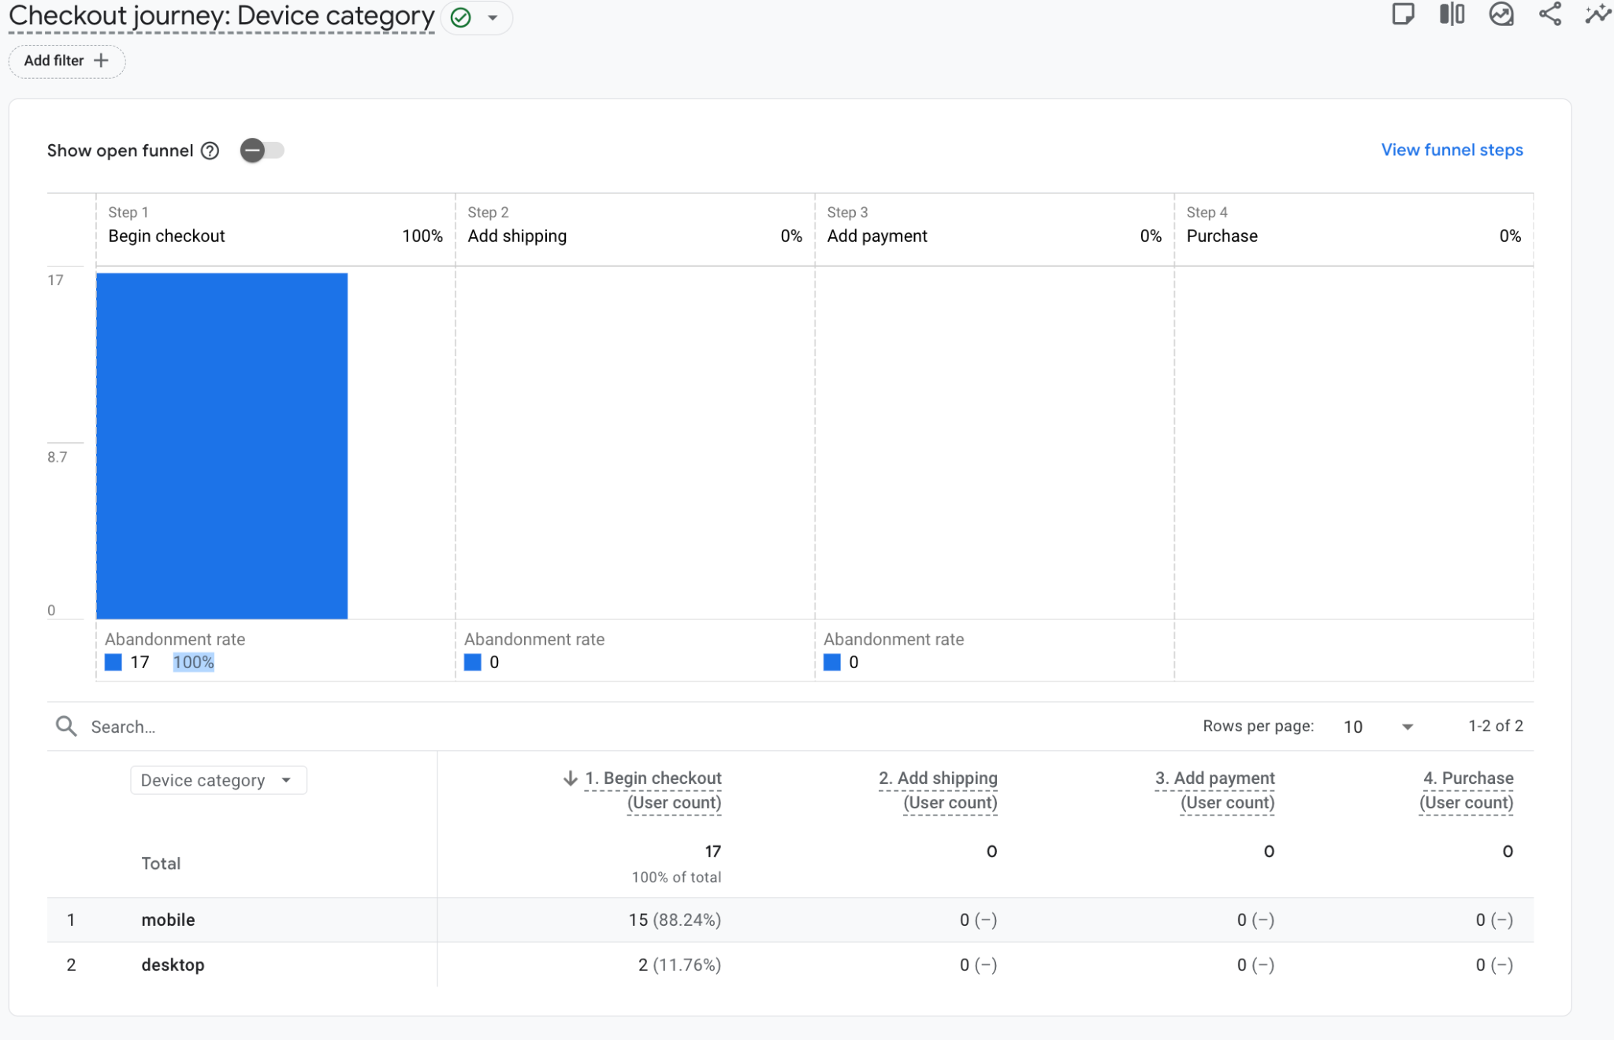
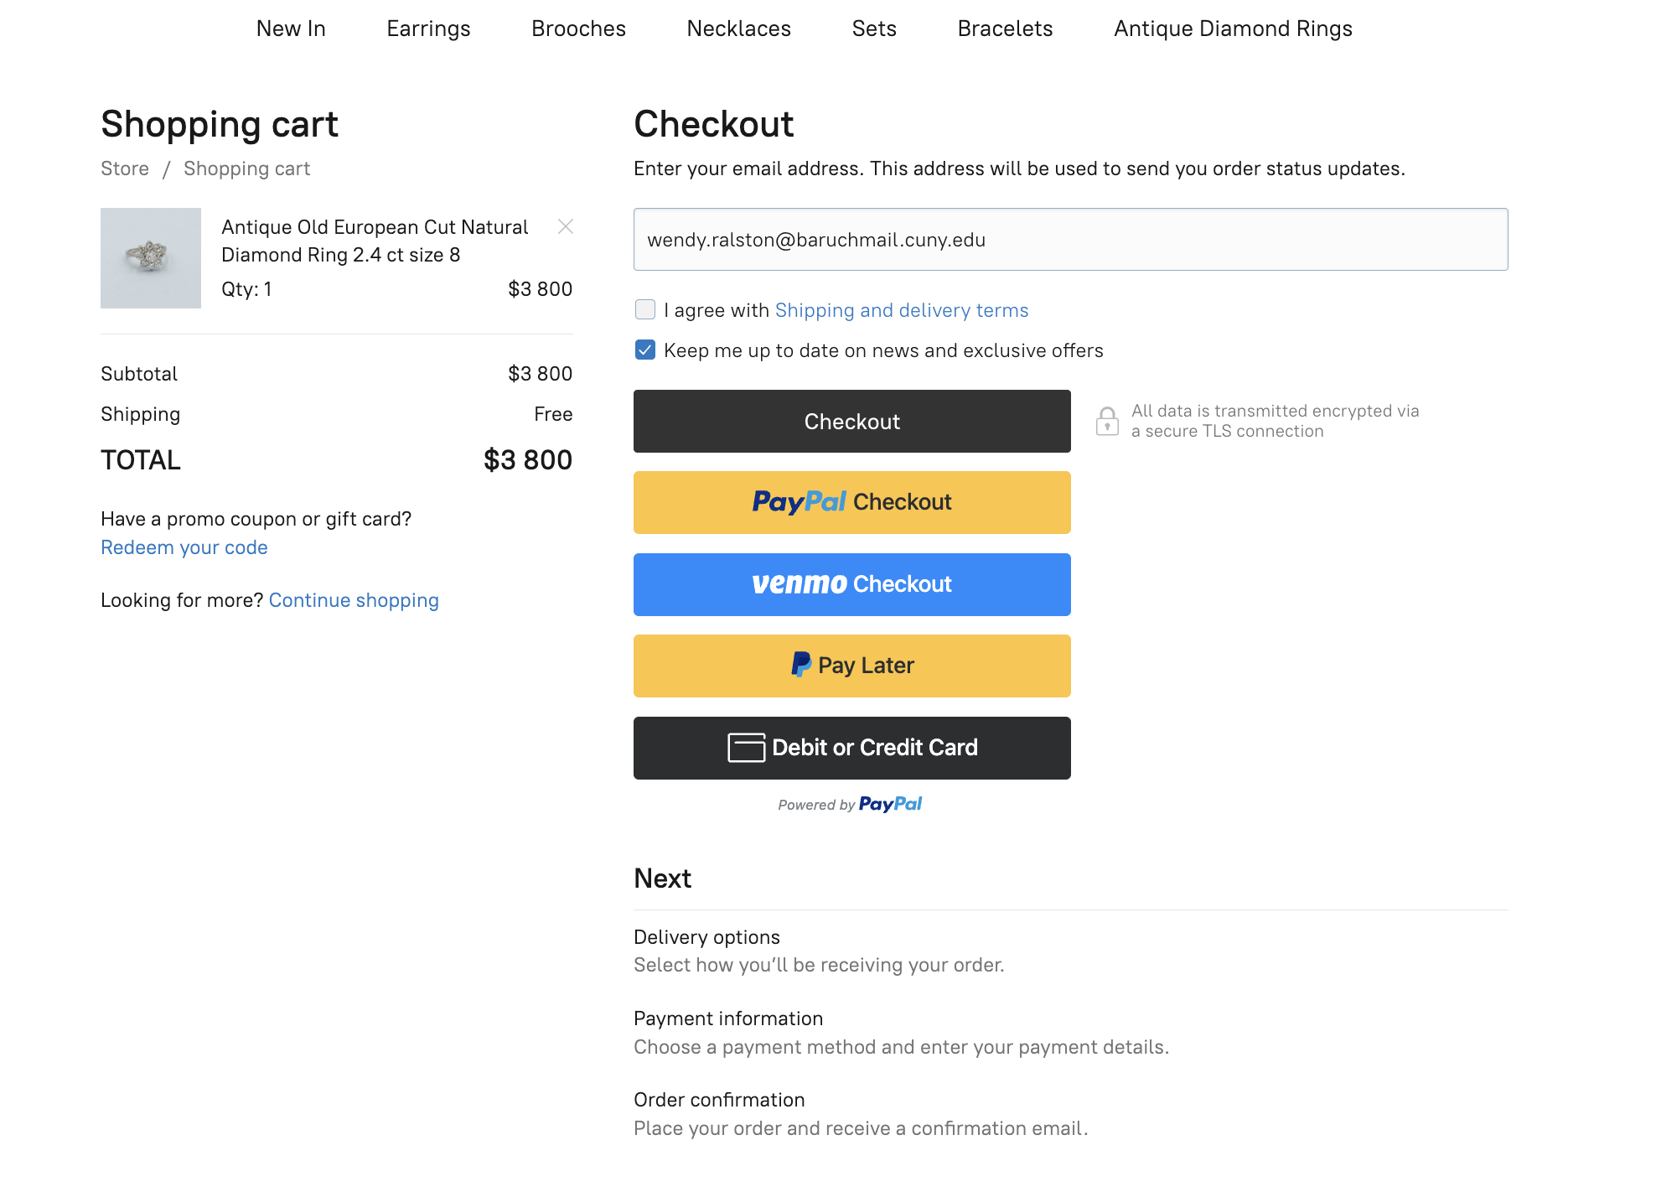
Cart Abandonment
Notes:
To show how critical these issues are, let’s start with a key insight from Moksha’s analysis: 100% of users drop off at the “Begin Checkout” step. That means customers intend purchase jewelry, but stopping short. This is likely because of a lack of trust and connection between the brand and the customer. Though this could be helped aesthetically by reorganizing the checkout page as seen on the right, a new brand approach may be even more effective.
To address this, we’re recommending a set of realistic, actionable changes that will help users get to know Anna and her work better before purchasing.

Slide 7
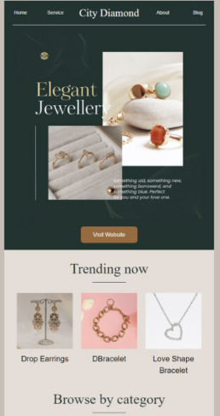
Actionable Marketing Fixes
Growth & Resolution
of Issues
Begin an Email Newsletter
Inexpensive
Customizable and versatile content
Establish a regular line of direct communication
Notes:
First, email. It’s a low-cost way for Anna to introduce herself and her brand to new potential customers and keep returning customers in the loop. Sending emails with new video content or exclusive product drops can create consistency and nudge users back to the site, which will convert more visitors into purchasers.

Slide 8
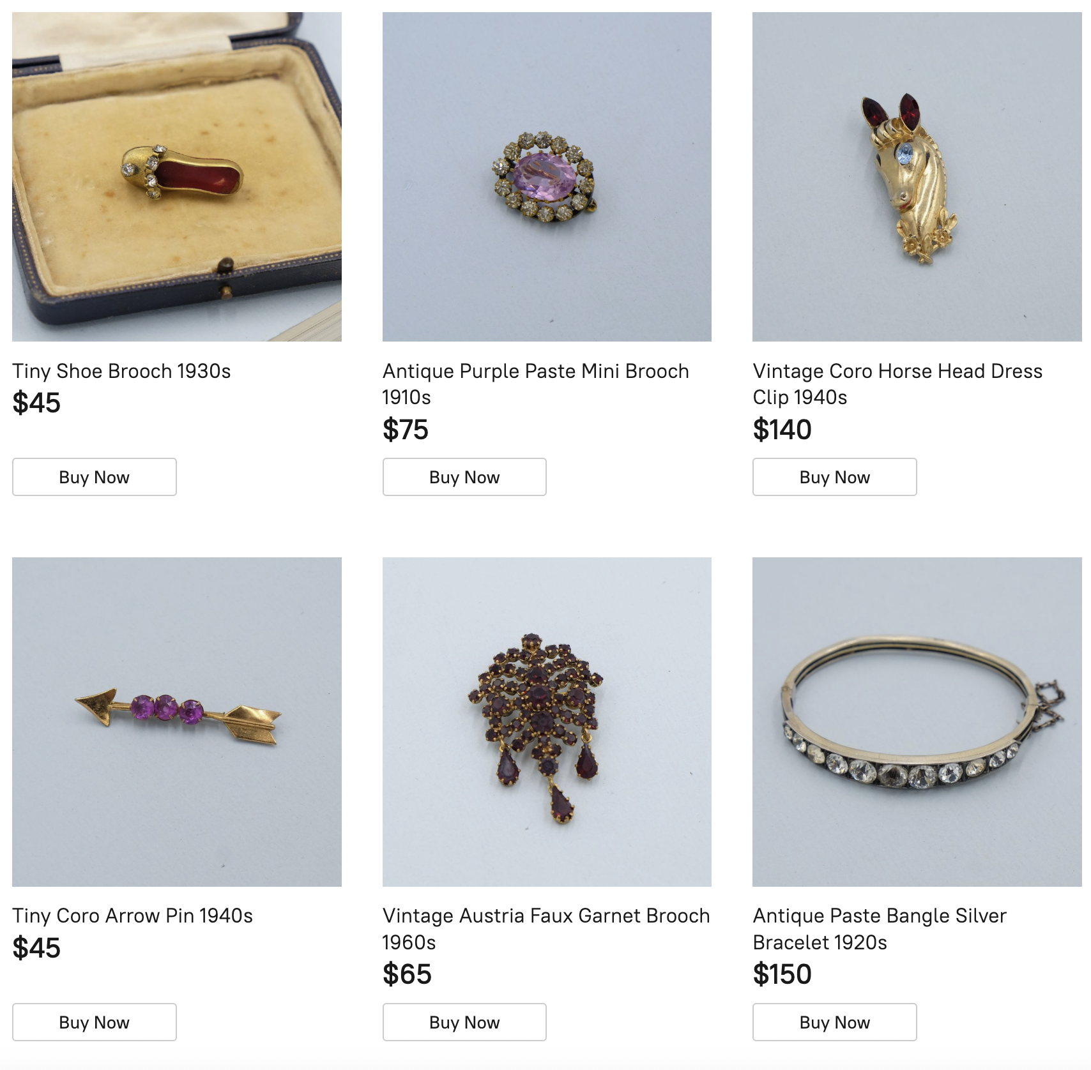
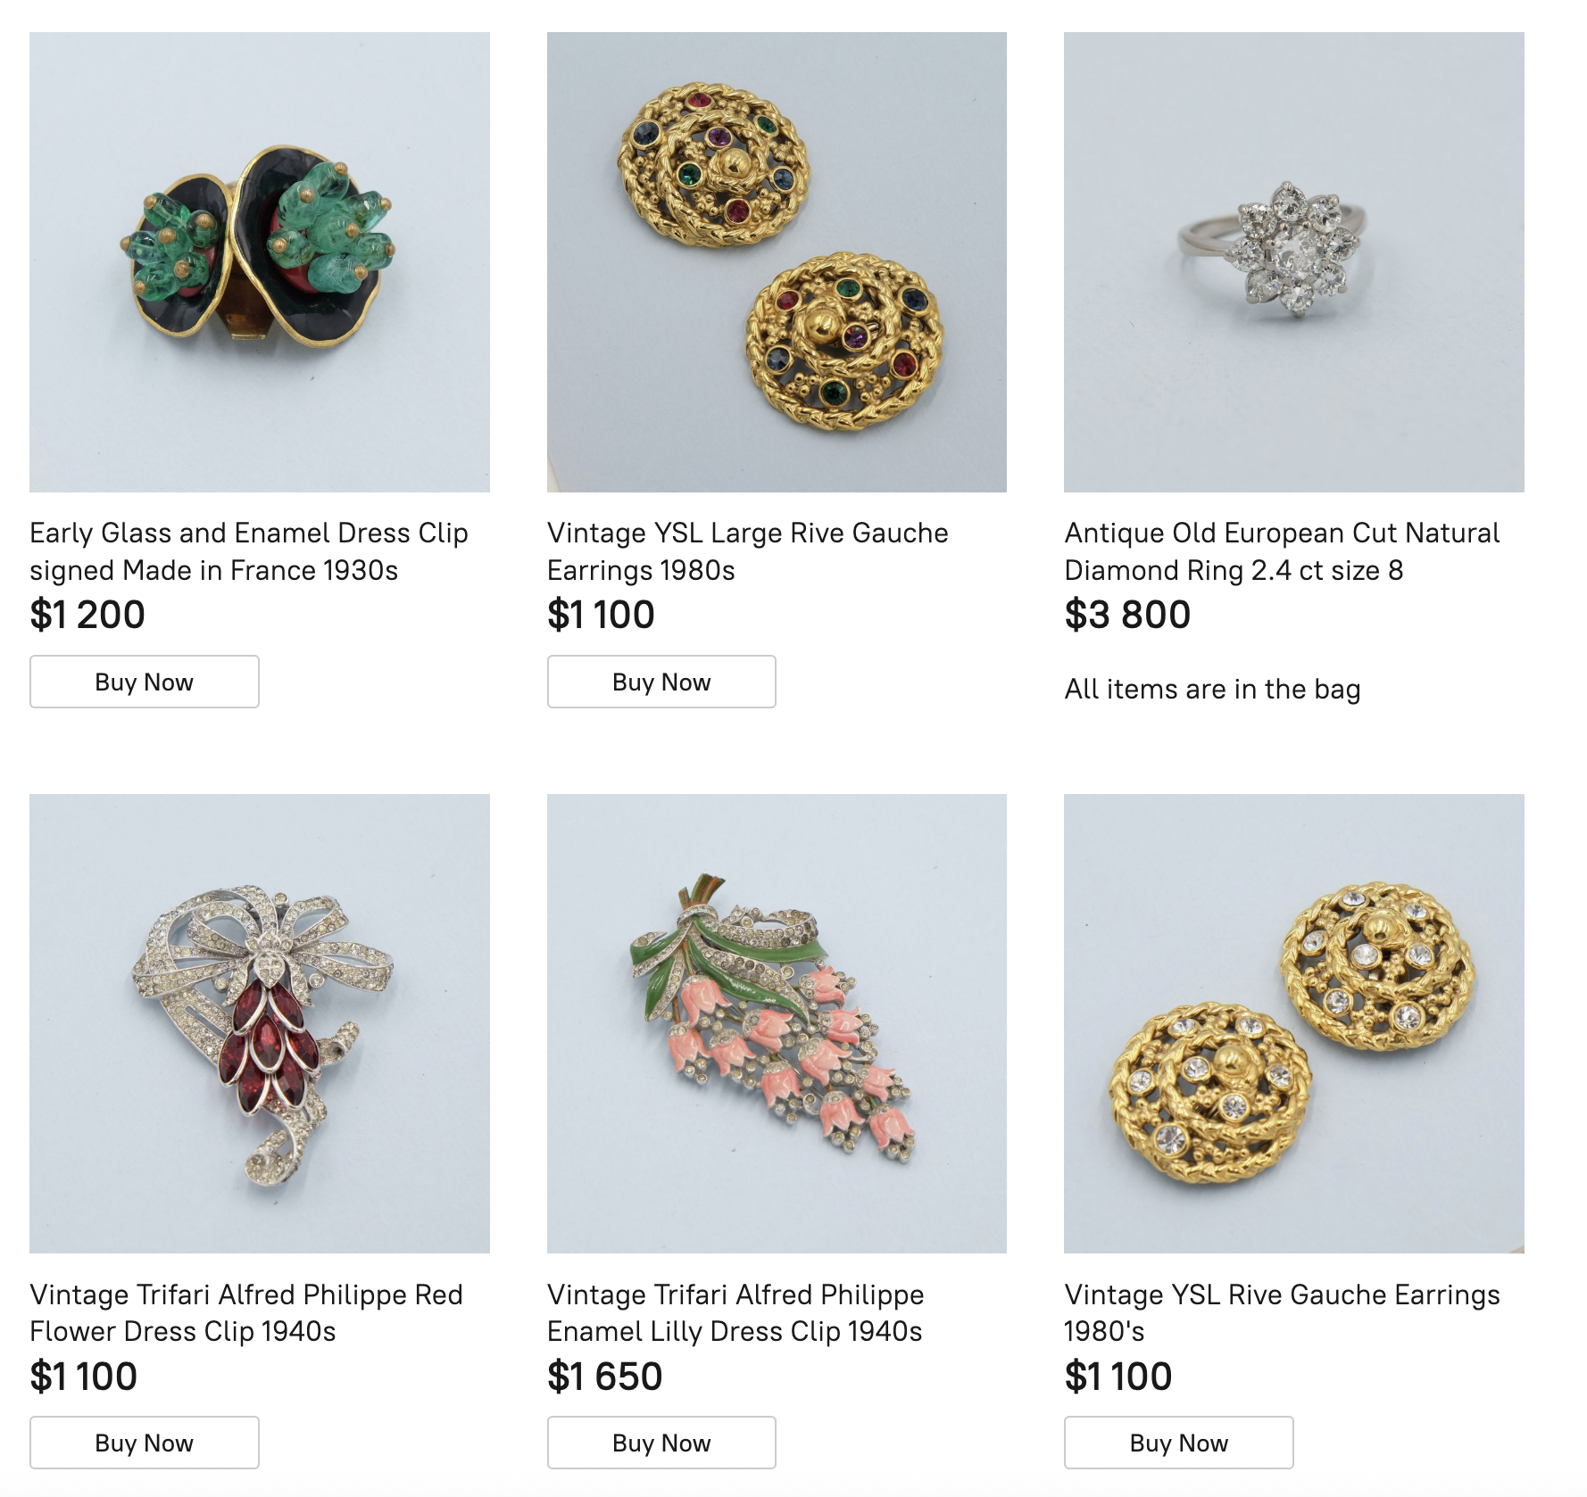
Actionable Marketing Fixes
Target Some Products to
Thrift/Flea Market Customers
Create a safer space for an initial purchase
Market products to the thrifting/flea market audience
Smaller pieces below $200
Integrate with a local NYC community
Collaborate with jewelry makers or others in the thrifting/flea market space on digital content
Thrift/Introductory
Premium
Growth & Resolution
of Issues
vs
Spectrum News Staff. “Thrifting: The Rising Shopping Trend.” Spectrum News, March 20, 2024. https://spectrumlocalnews.com/nys/central-ny/news/2024/03/20/thrifting--the-rising-shopping-trend
Sachmechi, Natasha. “Brooklyn Flea Market Reaches Deal to Stay in DUMBO’s Archway Plaza.” New York Business Journal, April 4, 2025. https://www.bizjournals.com/newyork/news/2025/04/04/brooklyn-flea-dumbo-agreement-archway-plaza.html
Dai, Serena. “Queens Night Market Reopens in April With Dozens of Food Vendors.” Eater NY, March 12, 2024. https://ny.eater.com/2024/3/12/24098404/queens-night-market-reopening-dates-2024
Notes:
Next, brand positioning. If every piece of jewelry is framed on the site as an expensive “investment,” users may hesitate to checkout and bounce instead. We need a way for customers like Sasha to be assured that they can trust Anna’s site without a big financial risk as the first step. So, we recommend introducing a separate page on the website for pieces under $200. This will provide customers like Sasha a distinct area to test out Anna’s jewelry. The page could also be used to gain a new customer base: NYC’s huge thrift and flea market community. The Brooklyn Flea and Queens Night Market draw over 25,000 visitors daily, and 62% of Gen Z and millennials, the generations Anna will want to start marketing to soon, prefer thrifting to traditional buying methods. Anna could also collaborate with local artists or vintage sellers to reach new audiences, increase visibility, and deepen community ties — something this demographic values.
A lower-priced, curated section can help Anna build trust and increase overall purchase frequency.

Slide 9
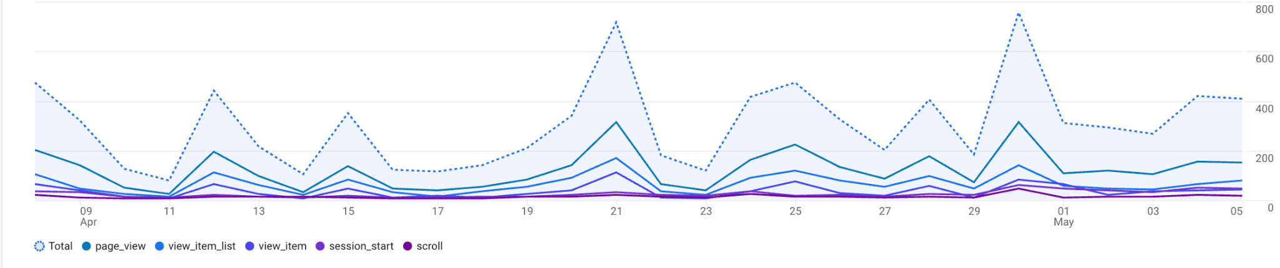
GA Fixes and Expectations
Actionable GA Fixes
Conversion Tags: “Email Signup”, “Purchase Complete”, “Referral”
Ensure that all conversions in the checkout process are set up properly
Growth KPIs
Bounce Rate ↓ 20%
Return Visitors ↑ 35%
Email Signups (new KPI to track)
Growth & Resolution
of Issues
Notes:
On the technical side, we’d implement a few changes as well via Google Analytics. We’d add conversion goals for “Email Signup” and “Referral” to track the previously mentioned changes, and make sure purchase events are tagged correctly in Google Tag Manager to avoid data gaps.
We’ve set a few KPIs: reduce bounce rate by 20%, increase return visitors by 35%, and we’ll track email signups as a new key funnel metric.
With those optimizations, Anna’s site can move from a one-time curiosity to a destination that people like Sasha will want to return to. I’ll now pass it to Darshi for broader strategy ideas.

Slide 10
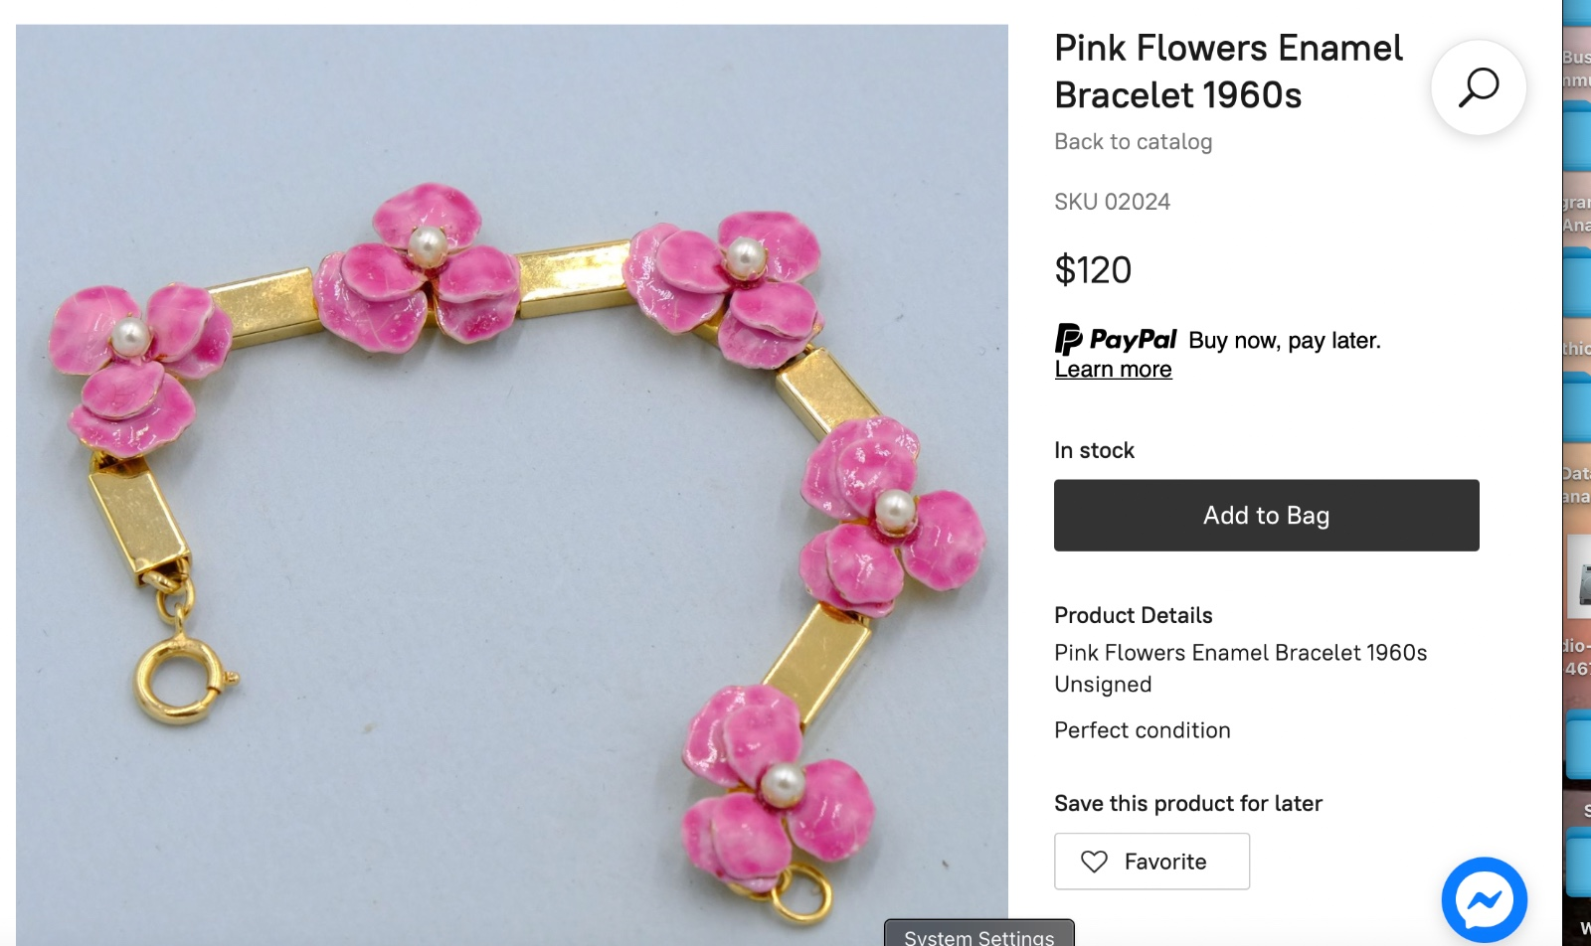
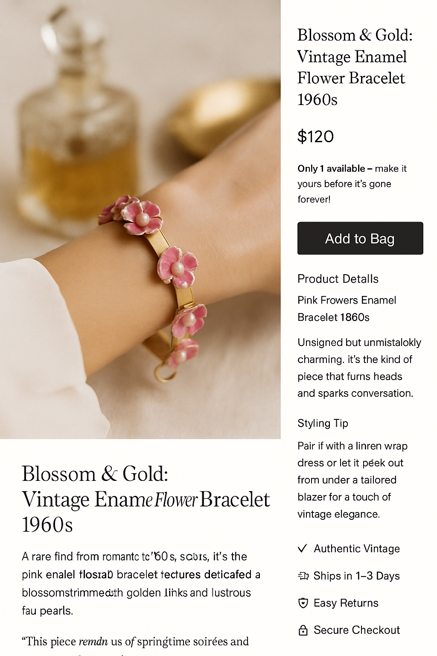
Short term Strategy
1. Clear, Compelling Value Propositions Each landing page should immediately convey what sets Antiques by Anna apart—whether it’s “Curated Vintage Finds”, “One-of-a-Kind Pieces with a Story”, or “Authenticated Historical Decor.” Use concise, engaging headlines with supportive subheads that reinforce trust, uniqueness, and quality. This ensures visitors instantly understand the value and character of what’s being offered.
2. Make It Feel Like a Curated Vintage Experience Transform the landing page into more than a catalog—make it feel like a walk through a thoughtfully designed boutique. Use warm, high-resolution lifestyle imagery that reflects the charm and authenticity of vintage pieces in real spaces. Highlight the story behind select items (era, origin, material), and group products by style (e.g., Mid-Century Modern, Victorian) to guide exploration.
3. Enhanced Visuals & Descriptions Avoid generic product shots and copy. Instead, use editorial-style photos that create ambiance, and write item descriptions that feel like personal introductions—highlighting history, craftsmanship, and ideal styling tips. The goal is to engage both emotion and imagination, encouraging visitors to envision the piece in their own lives.
Before
Strategy Goals
After
Notes:
Here’s a short, presentation-ready script:
To elevate Antiques by Anna’s landing pages, we recommend three key enhancements. First, lead with clear, compelling value propositions—like “Curated Vintage Finds” or “Authenticated Historical Decor”—to instantly communicate what sets the brand apart.
Second, transform the site into a curated boutique experience using warm lifestyle imagery and storytelling that highlights each piece’s origin and style.
Finally, enhance visuals and descriptions by replacing generic shots with editorial-style photography and rich, engaging copy that brings each item to life. Together, these changes will create a more immersive, emotional shopping journey that boosts engagement and retention.

Slide 11
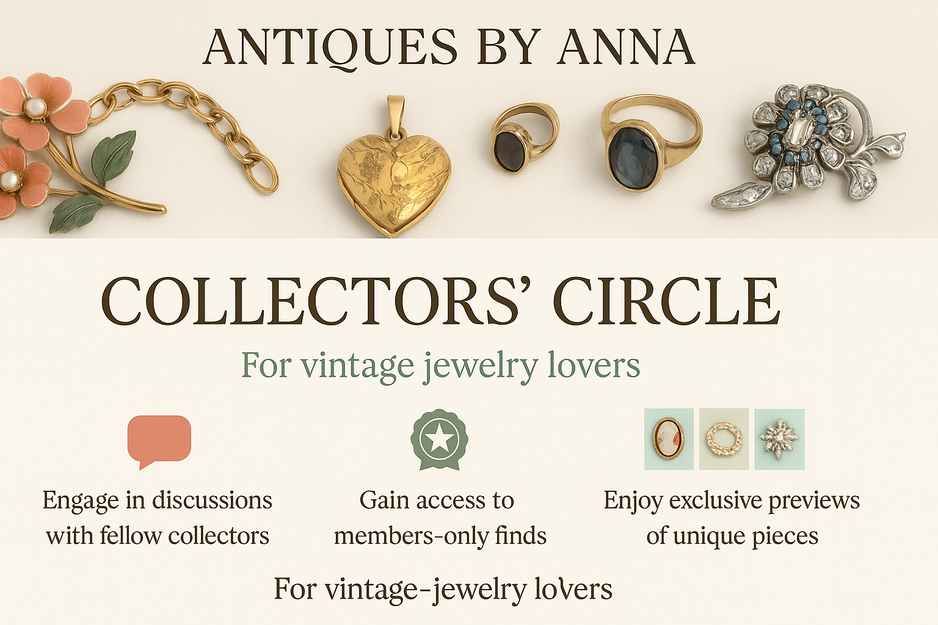
Long‑Term Strategy & Bigger Ideas
Content & Community Hub
Collectors’ Circle – Premium Loyalty Program Launch a paid “Collectors’ Circle” membership offering:
Early access to new arrivals and exclusive limited-edition finds
Monthly webinars on antique care, history, and restoration tips
Reward points on every purchase, redeemable for future discounts
Access to a private Facebook group or Slack community where members can share finds, ask for advice, and connect with fellow vintage lovers—driving repeat visits and emotional brand loyalty
Strategy Goals
Notes:
As part of our long-term strategy, we propose launching a Collectors’ Circle—a premium loyalty program designed to deepen engagement and build community.
Members would get early access to exclusive pieces, monthly webinars on antique care, and reward points for every purchase. The program would also include a private Facebook or Slack group, fostering connection and brand loyalty among vintage enthusiasts.
This not only incentivizes repeat visits but turns casual shoppers into invested members of the Antiques by Anna community.

Slide 12
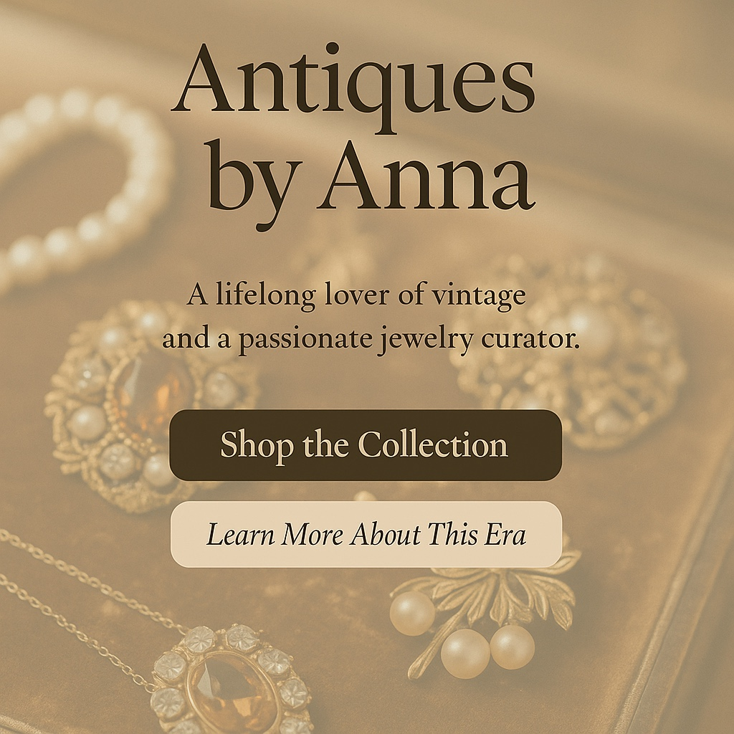
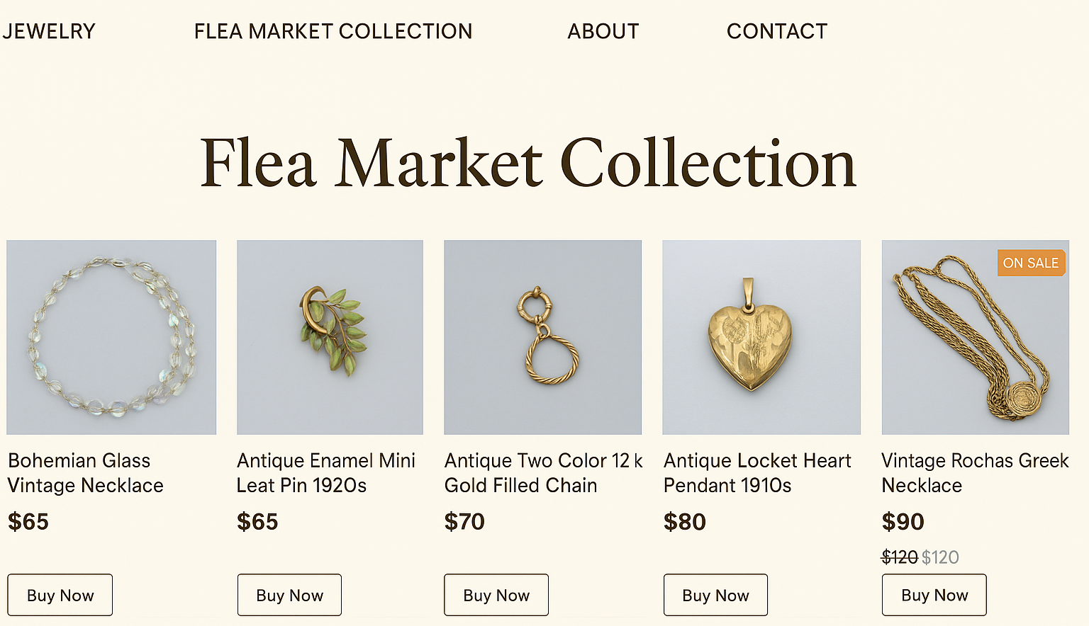
2. Streamlined Navigation & Calls‑to‑Action
Simplified User Journey
Trim down navigation to key product categories (e.g., Bracelet, Jewelry, Art, Earrings) for less friction
Feature 1–2 bold CTAs on landing pages such as:
“Shop the Collection”
“Learn More About This Era”
These encourage action without overwhelming the visitor
Dedicated Section: Limited-Time Flea Market Collection
Add a rotating homepage spotlight banner or featured section to showcase:
“This Week’s Flea Market Finds”
Countdown timers or tags like “Limited Edition” or “Gone Soon!”
Direct links to shop exclusive items only available during flea market periods
Strategy Goals
Notes:
To simplify the user experience, we recommend streamlining navigation to just the core product categories—like Furniture, Jewelry, and Art—making it easier for visitors to find what they’re looking for.
Landing pages should feature one or two bold calls-to-action, such as “Shop the Collection” or “Learn More About This Era,” to guide users without overwhelming them.
We also suggest adding a dedicated section for limited-time flea market finds, highlighted through a rotating homepage banner with countdown timers or “Gone Soon!” tags. This creates urgency, drives engagement, and keeps the site feeling fresh and event-driven.

Slide 13
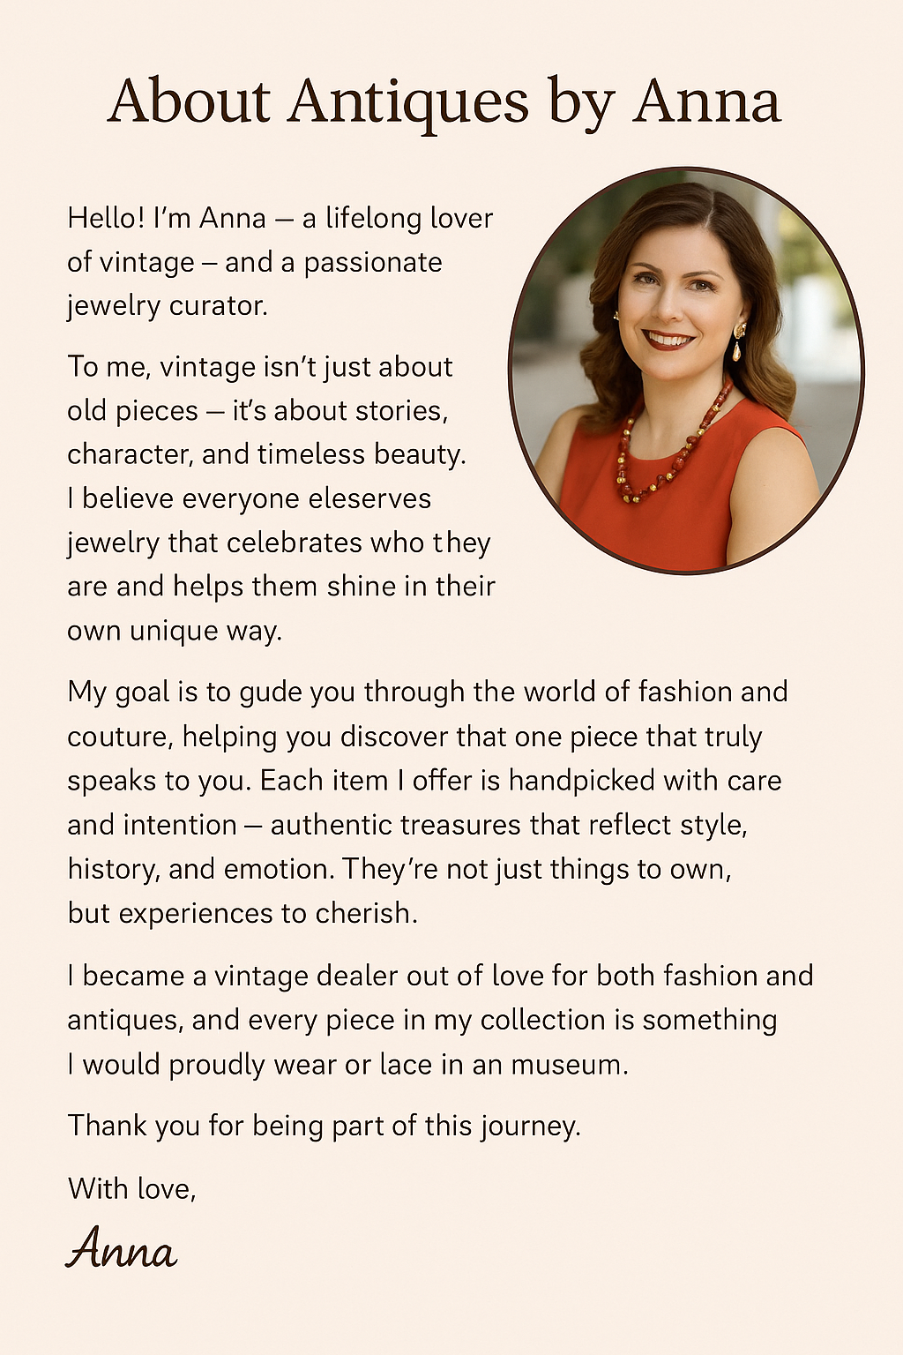

Conclusion
In summary, our analysis identified key ways Antiques by Anna can reduce bounce rates, increase engagement, and build lasting customer loyalty.
Enhancing landing page design, using personalized and story-driven content, and incorporating social proof will strengthen first impressions and retention.
Quick wins like conversion tracking and email campaigns offer immediate gains, while long-term efforts like content hubs and loyalty programs will grow brand equity.
With a balanced approach of data-driven improvements and creative strategy, Antiques by Anna can become a go-to destination that offers not just antiques, but meaningful experiences and inspiration.
“When you tell a story, you don’t just sell a product — you create a memory”
Notes:
To wrap up, our analysis highlights key opportunities for Antiques by Anna to reduce bounce rates, boost engagement, and foster long-term loyalty.
By improving landing page design, adding personalized, story-driven content, and leveraging social proof, the site can make a stronger first impression.
Quick wins like conversion tracking and email campaigns can drive immediate results, while long-term strategies like content hubs and loyalty programs will build lasting brand equity.
With a thoughtful blend of data and creativity, Antiques by Anna can evolve from an online store into a destination that offers rich experiences and lasting inspiration.

Slide 14
Thank You

